Slide 1
Preparing for Potential Closure of European Airspaces due to Re-entering Space Objects
E. Spinielli, R. Koelle, Q. Goens Aviation Intelligence Unit Aviation Transformation Directorate
Presenter: Rainer KOELLE Montreal, Canada 16-18 Sep 2025

Slide 2
Summary
What this study is about
Why performing it
Who: institutional and geographical scope
How: method, assumptions and simplifications
Reproducibility and Thanks
Future work
Q&A

Slide 3
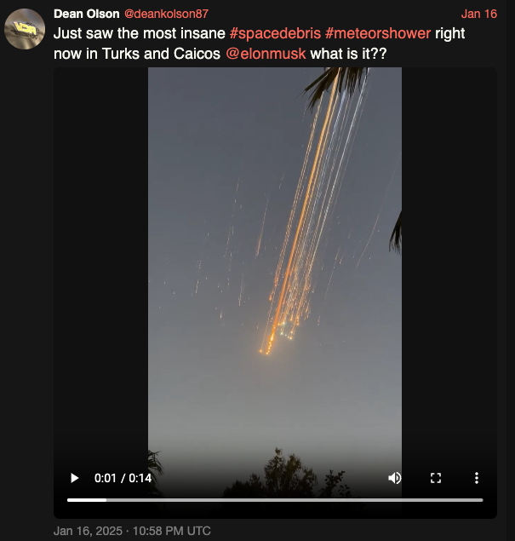
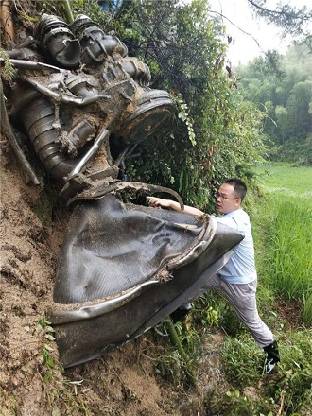
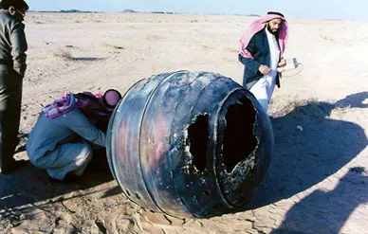
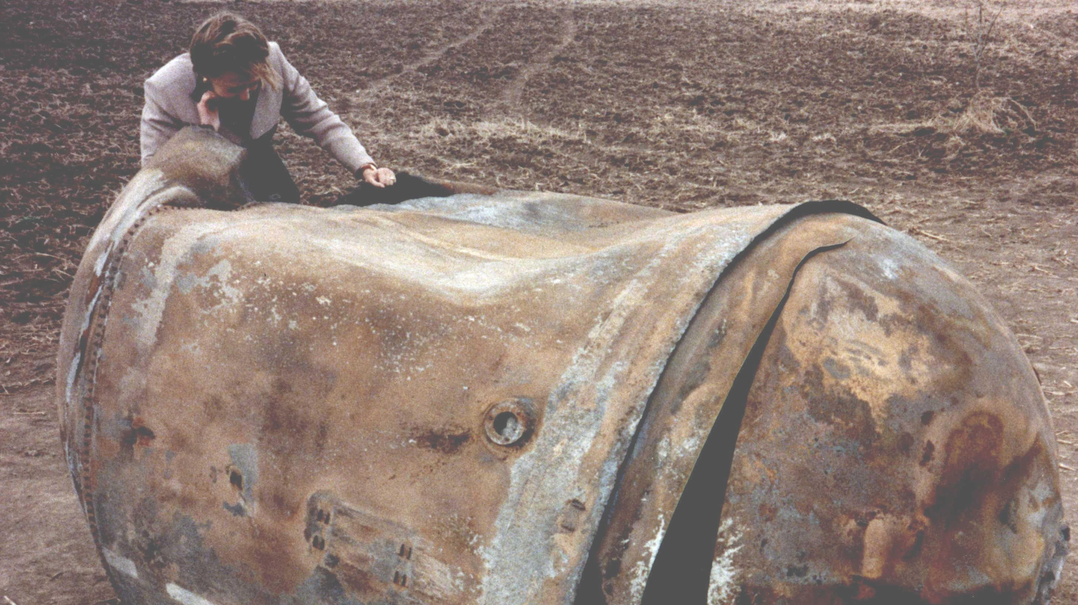
What: debris falling from the sky impact on (EU) Aviation
Space missions result in debris re-entering Earth’s atmosphere
Re-entries can be controlled or uncontrolled (launch failure, satellite end of life, …)
We focus on impact on airborne flights, not on people/buildings/… on the ground
Notes:
While we focus on uncontrolled re-entries, the analysis applies to controlled ones (launch failures, controlled end-of-life satellite re-entry)
IMPORTANT: we focus on impact on AIRBORNE portion of a flight. The pictures shown are just to impress ;-)

Slide 4
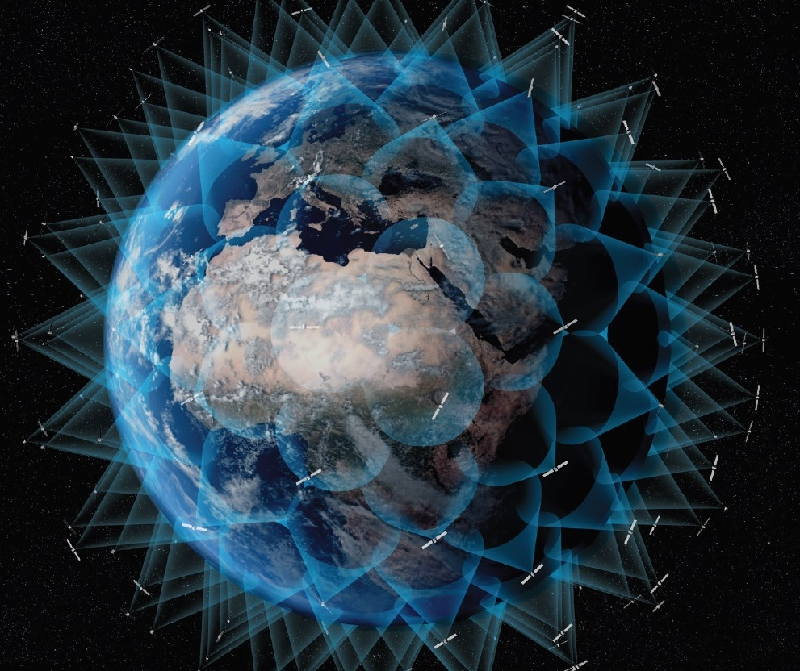
Why dealing with Space Debris in Aviation? 1/2
Safety: Damage caused by re-entering debris to a flying aircraft could cause hundreds of casualties
Awareness: growing number of LEO satellites (constellations of thousands!) increases the occurrence of uncontrolled re-entries. Let’s quantify the risk!
Resilience: be ready to consistently put measures in place on short notice & rationally (rather than emotionally)

Slide 5
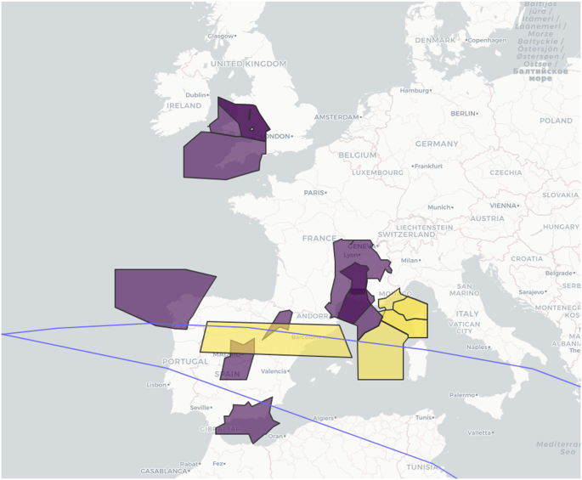
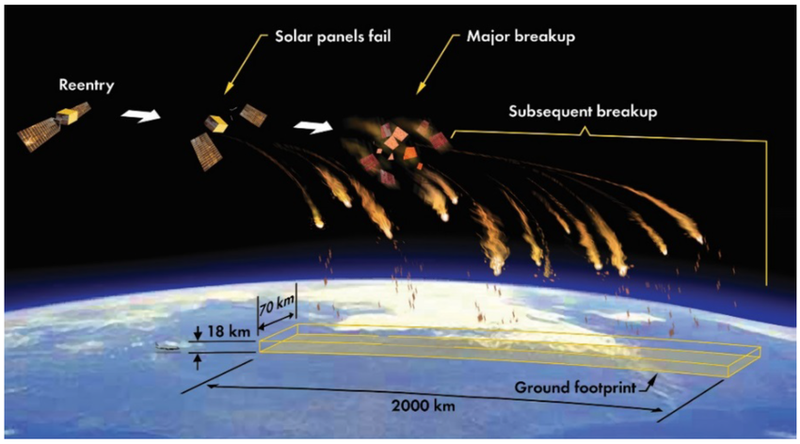
Why dealing with Space Debris in Aviation? 2/2
Long March 5B reentry tracks (blue line) over EU zero rate (closure) NOTAMs in yellow non-zero rate (advisory) NOTAMs in purple. [3]
lack of harmonization of responses among States impacted by Long March 5B reentry on 4th Nov 2022
4 November 2022
Notes:
This is to show inconsistent measures from different ANSPs to a re-entry event: mix of closures and non-zero rate measures

Slide 6
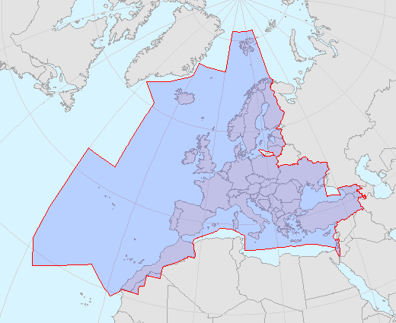

Who: EUROCONTROL
43 Member States’ FIRs (NM Area, blue area)
Analysis for bounding box containing all FIRs
Use full flight trajectories as IFR flights filed/flown by airspace users crossing NM Area; past works used as proxies for trajectories
Population density
ADS-B position reports (including on ground and no flight type distinction, IFR/VFR, GA, …)
Area, $𝒶$, of the study
Notes:
Who we are and the area we focus on: FIRs for our 43 Member States. In fact we use a bounding box including it.
We analyse the geographical bounding box enclosing the NM Area.
Past approaches used proxies to flight densities such population density and ADS-B position reports (BUT all of them, ground/airborn, general aviation, …AND no coverage outside landmasses)

Slide 7
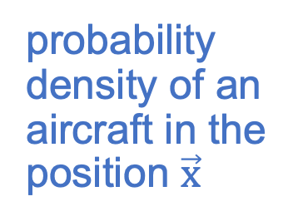
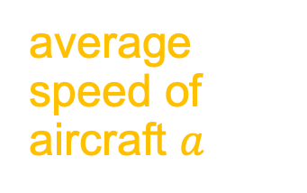
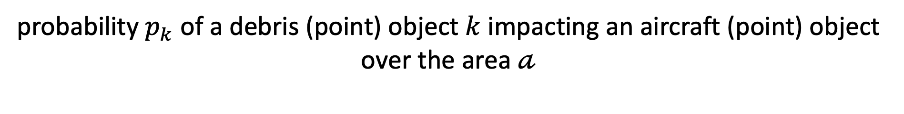
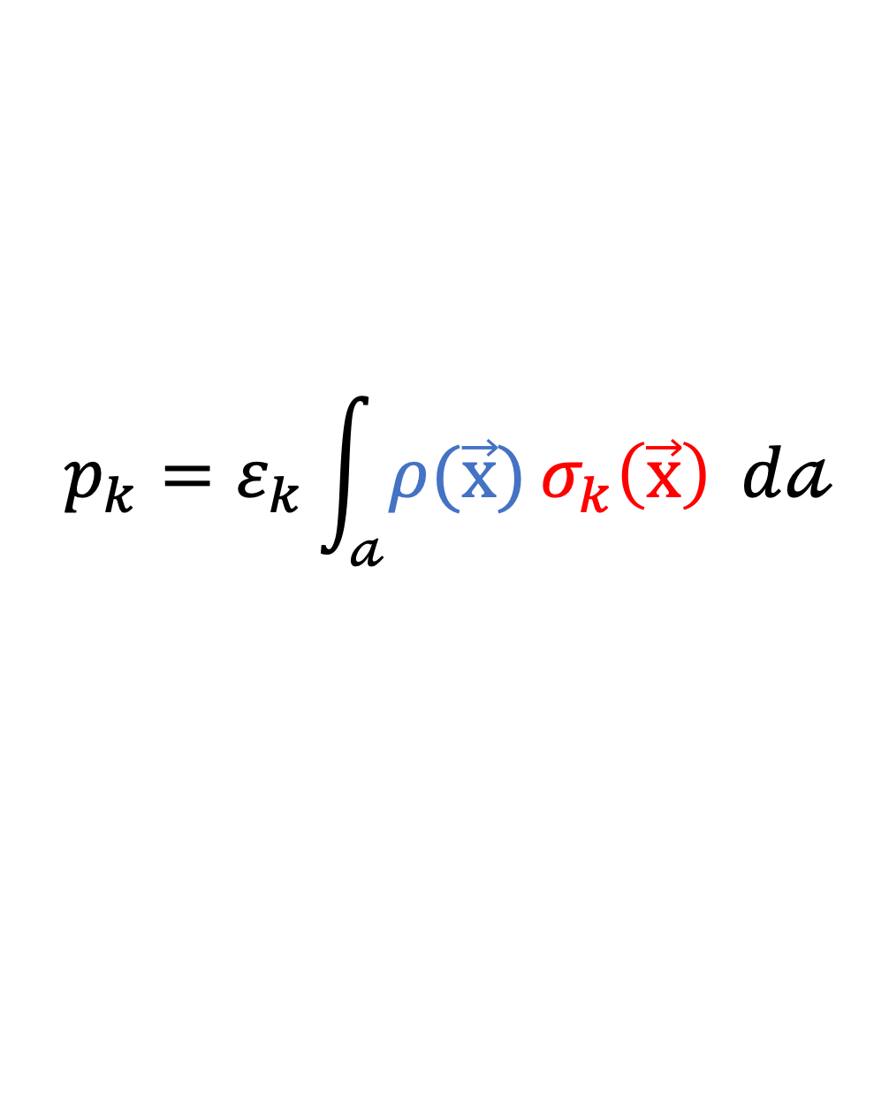
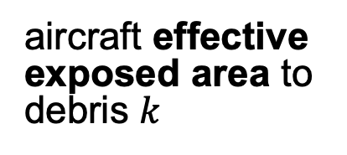
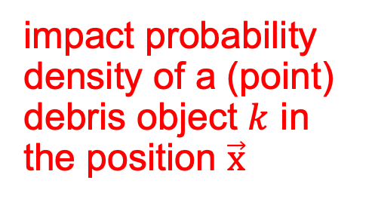
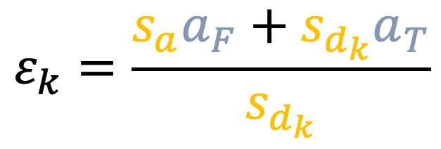


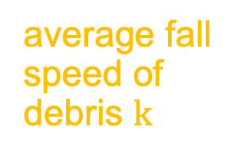


Method: Step 1, general formulation
probability $p_{k}$ of a debris (point) object $k$ impacting an aircraft (point) object over the area $𝒶$
aircraft area viewed from Front
probability density of an aircraft in the position $\vec{x}$
aircraft area viewed from Top
aircraft effective exposed area to debris $k$
$$p_{k}=ε_{k}\int_{𝒶}^{ }{ρ(\vec{x})}σ_{k}\left(\vec{x}\right) ⅆ𝒶$$
$$ε_{k}=\frac{s_{a}a_{F}+s_{d_{k}}a_{T}}{s_{d_{k}}}$$
area $𝒶$ of interest
impact probability density of a (point) debris object $k$ in the position $\vec{x}$
average speed of aircraft $a$
average fall speed of debris $k$
Notes:
All the game is about combining aircraft probability densities with debris impact probability densities

Slide 8
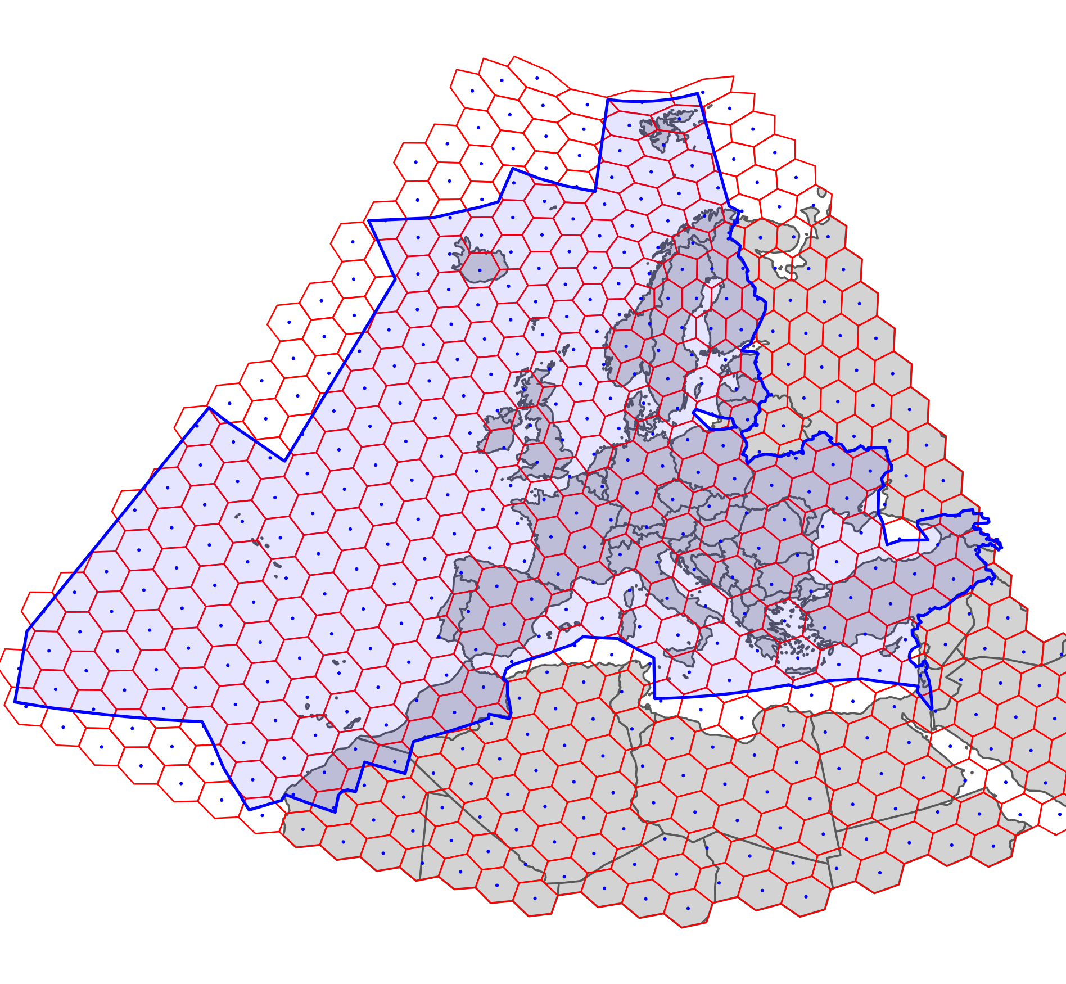
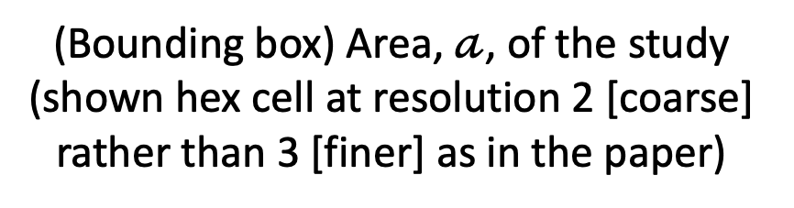
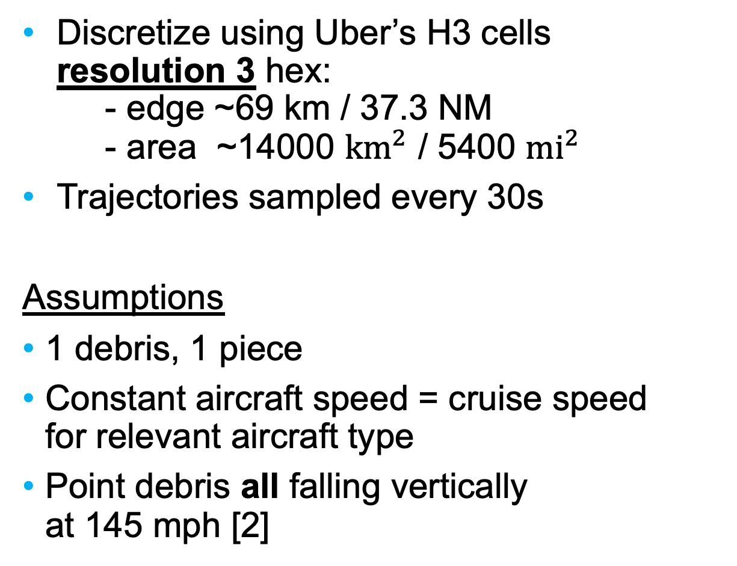
Step 2.1, discretize & assumptions
Discretize using Uber’s H3 cells resolution 3 hex: - edge ~69 km / 37.3 NM - area ~14000 ${km}^{2}$ / 5400 ${mi}^{2}$
Trajectories sampled every 30s
Assumptions
1 debris, 1 piece
Constant aircraft speed = cruise speed for relevant aircraft type
Point debris all falling vertically at 145 mph [2]
(Bounding box) Area, $𝒶$, of the study (shown hex cell at resolution 2 [coarse] rather than 3 [finer] as in the paper)
Notes:
Vertically falling debris is a pretty good approx…some calculations give 86 degrees. The assumption for 1 debris 1 piece is a semplification because break down can and usually creates a shower of pieces (but many will burn out then)…but hey we need to survive complexity.
Constant speeds are a good and simplifying compromize.
Similarly sampling of trajectories at 30 s makes computational complexity manageable.

Slide 9

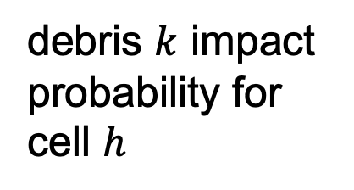

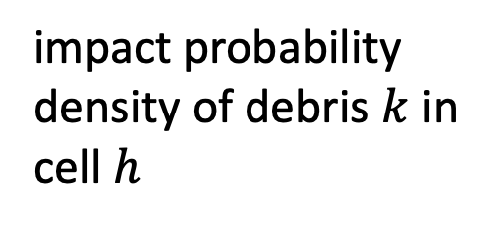
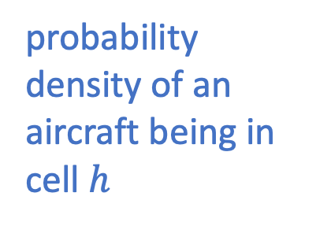
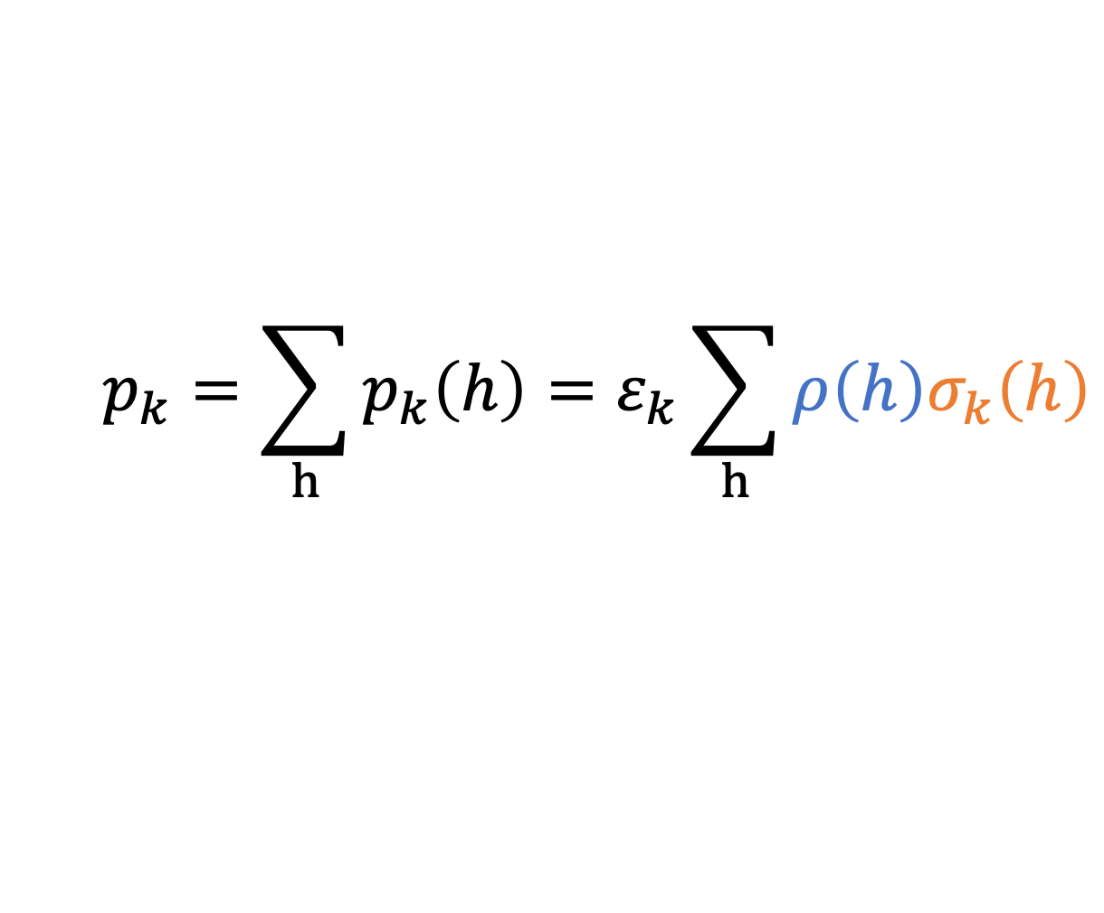

Step 2.2, discretize + assumptions
probability density of an aircraft being in cell $h$
debris $k$ impact probability for cell $h$
$$p_{k}=\sum_{h}{p_{k}\left(h\right)}=ε_{k}\sum_{h}{ρ\left(h\right)σ_{k}\left(h\right)}$$
impact probability density of debris $k$ in cell $h$

Slide 10
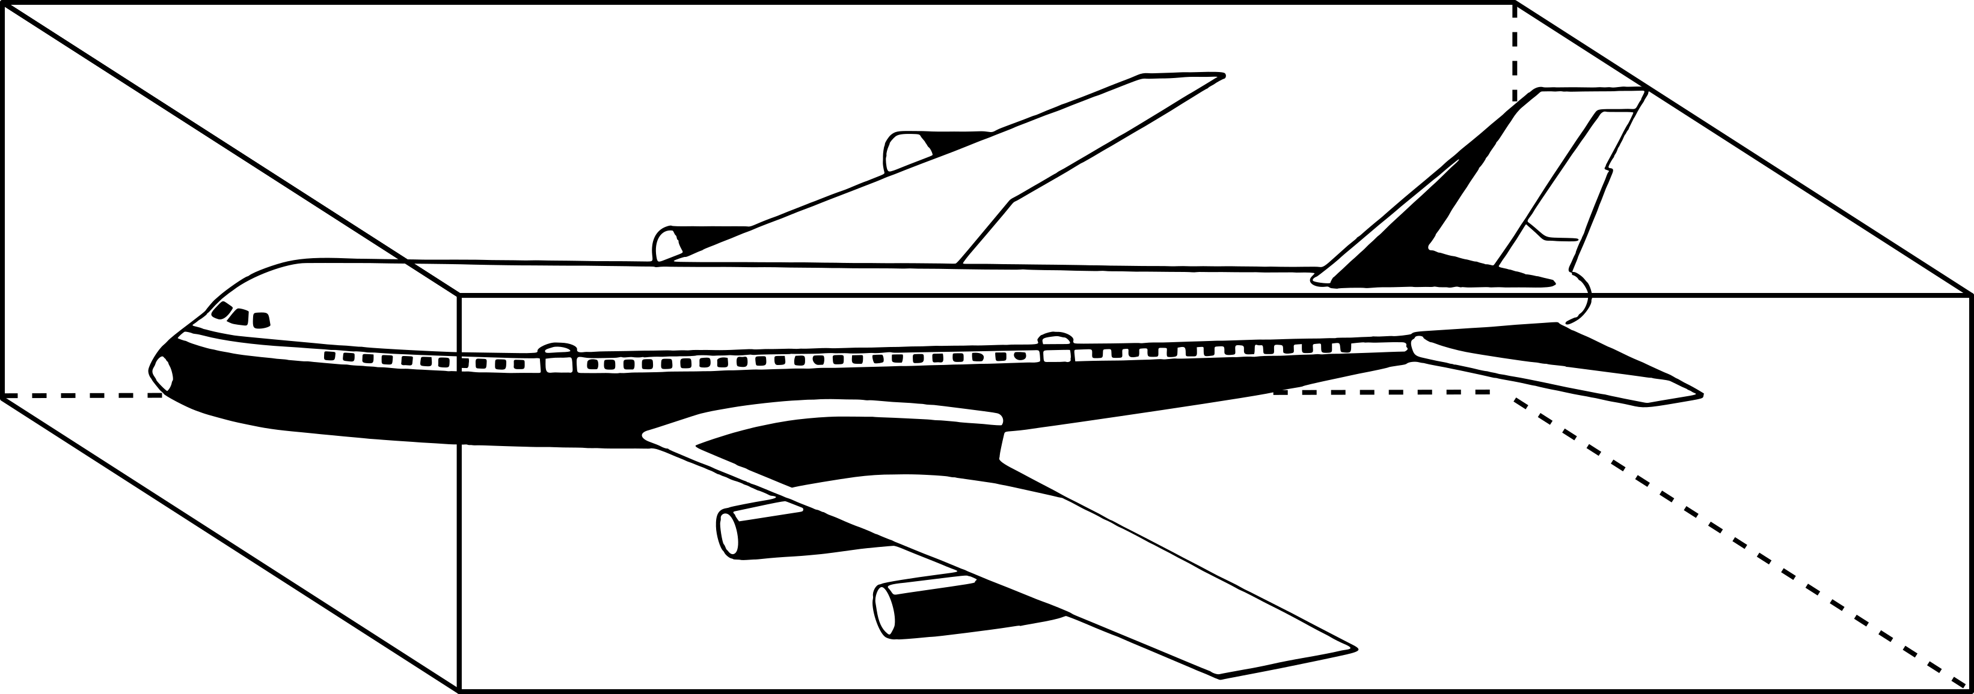


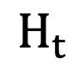
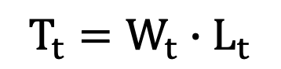
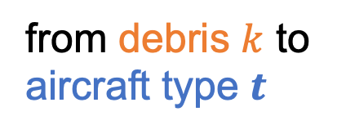


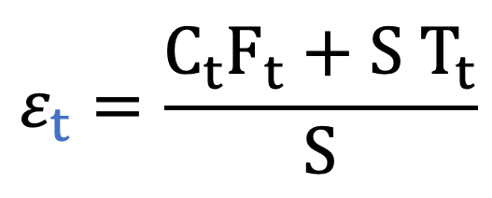

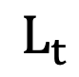
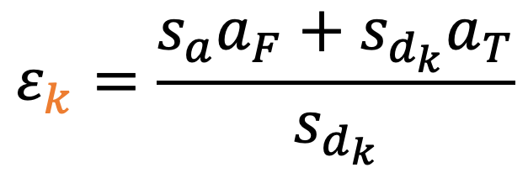
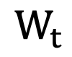

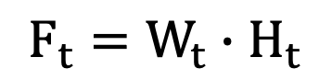
Step 2.3, discretize + assumptions
aircraft effective exposed area
area from Front / Top
$$ε_{k}=\frac{s_{a}a_{F}+s_{d_{k}}a_{T}}{s_{d_{k}}}$$
$$ε_{t}=\frac{C_{t}F_{t}+S{ T}_{t}}{S}$$
from debris $k$ to aircraft type $t$
constant fall speed for any debris
cruise speed for aircraft type $t$
$$L_{t}$$
$$H_{t}$$
$$F_{t}=W_{t}∙H_{t}$$
$$W_{t}$$
$$T_{t}=W_{t}∙L_{t}$$
Notes:
The constant speeds simplification makes it possible to calculate the aircraft effective exposed area from aircraft parameters only

Slide 11
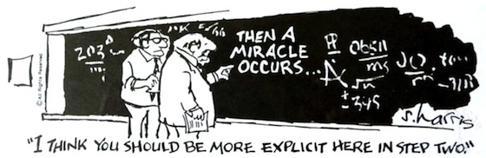
Method: step 2
Notes:
I couldn’t resist to use this hilarious illustration by Sydney Harris

Slide 12


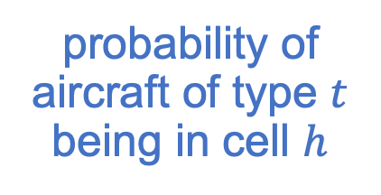


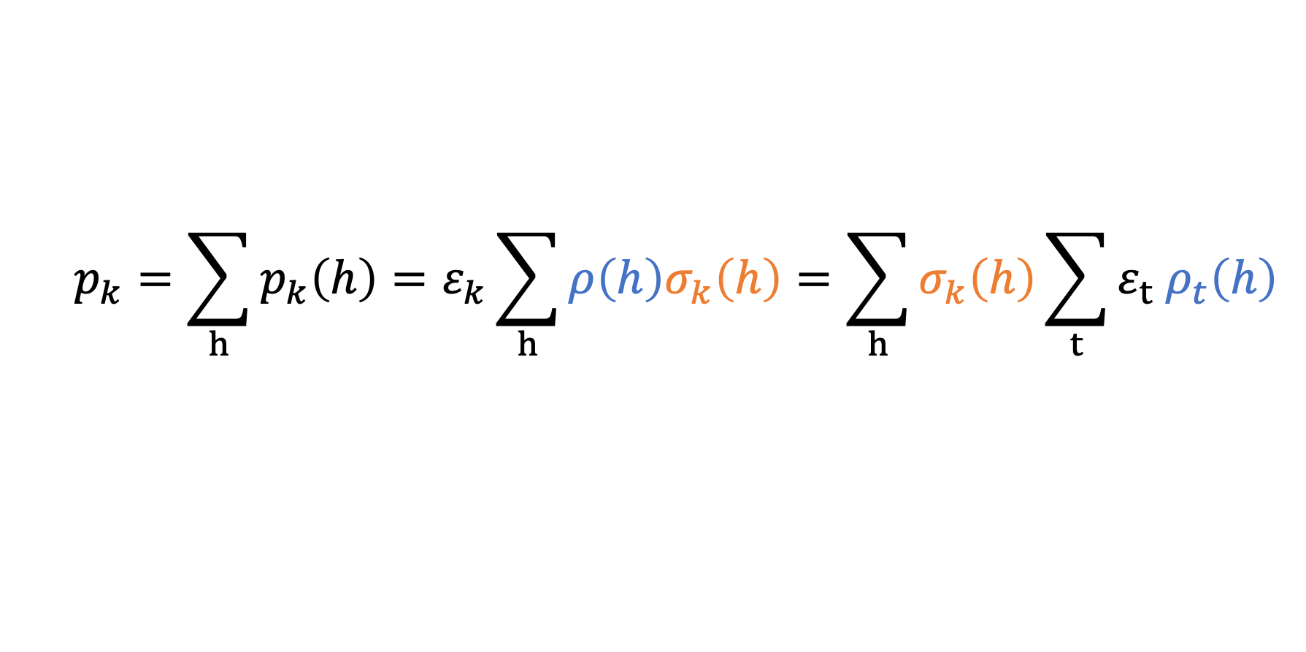


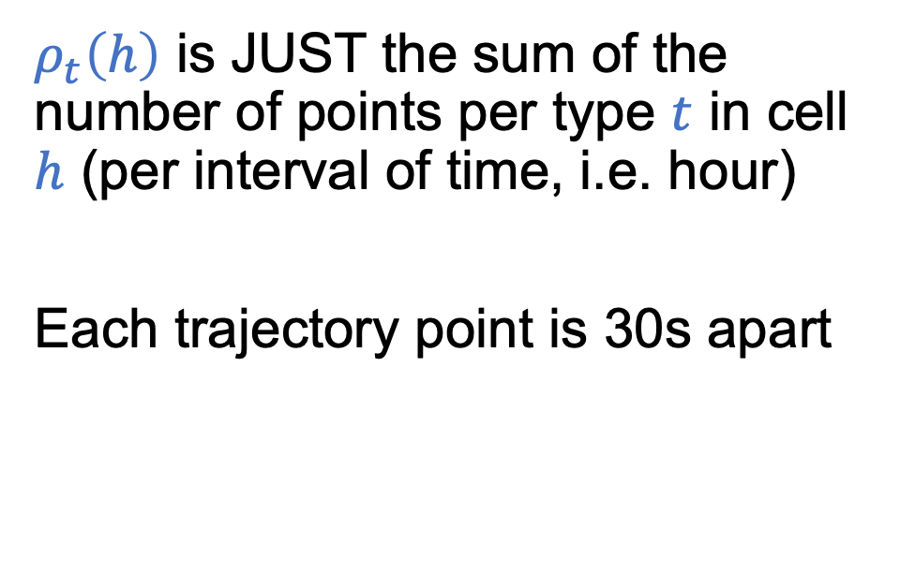
Step 3, aircraft probability density
$$p_{k}=\sum_{h}{p_{k}\left(h\right)}=ε_{k}\sum_{h}{ρ\left(h\right)σ_{k}\left(h\right)}=\sum_{h}{σ_{k}\left(h\right)\sum_{t}{ε_{t}{ ρ}_{t}\left(h\right)}}$$
probability of aircraft of type $t$ being in cell $h$
$ρ_{t}\left(h\right)$ is JUST the sum of the number of points per type $t$ in cell $h$ (per interval of time, i.e. hour)
Each trajectory point is 30s apart
Type 1
Type 2
Type 2
Notes:
Aircraft probability density is just counting of dots in each cell in each hour per aircraft type

Slide 13
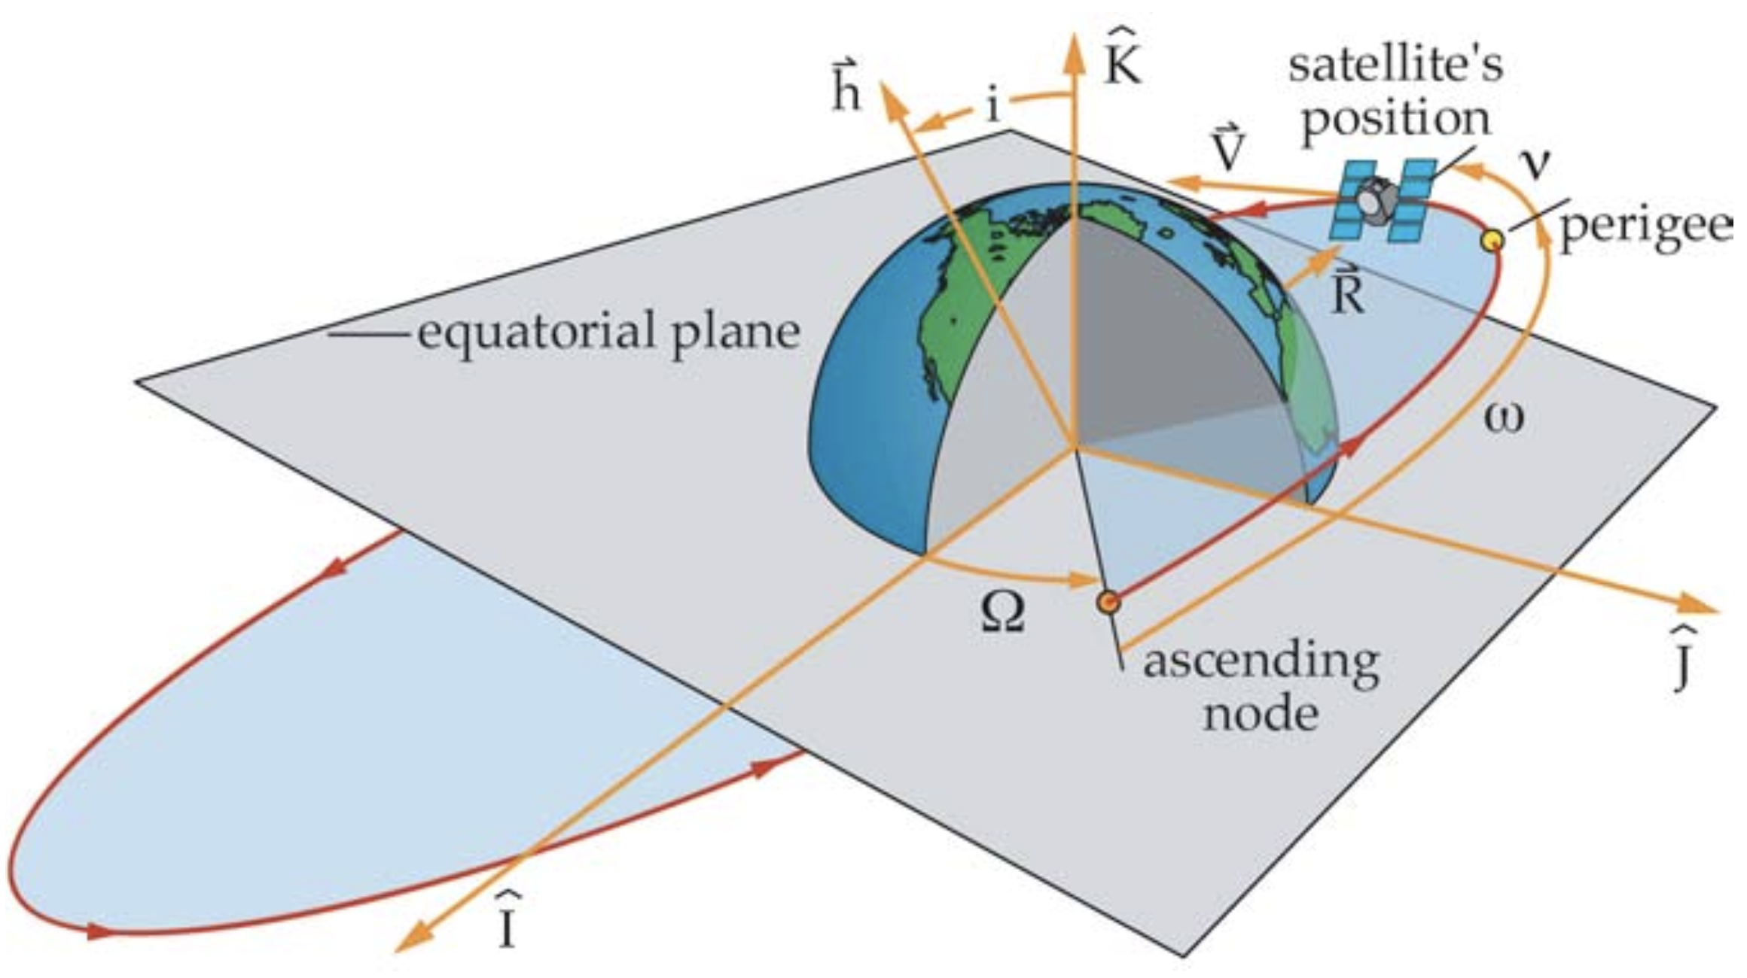
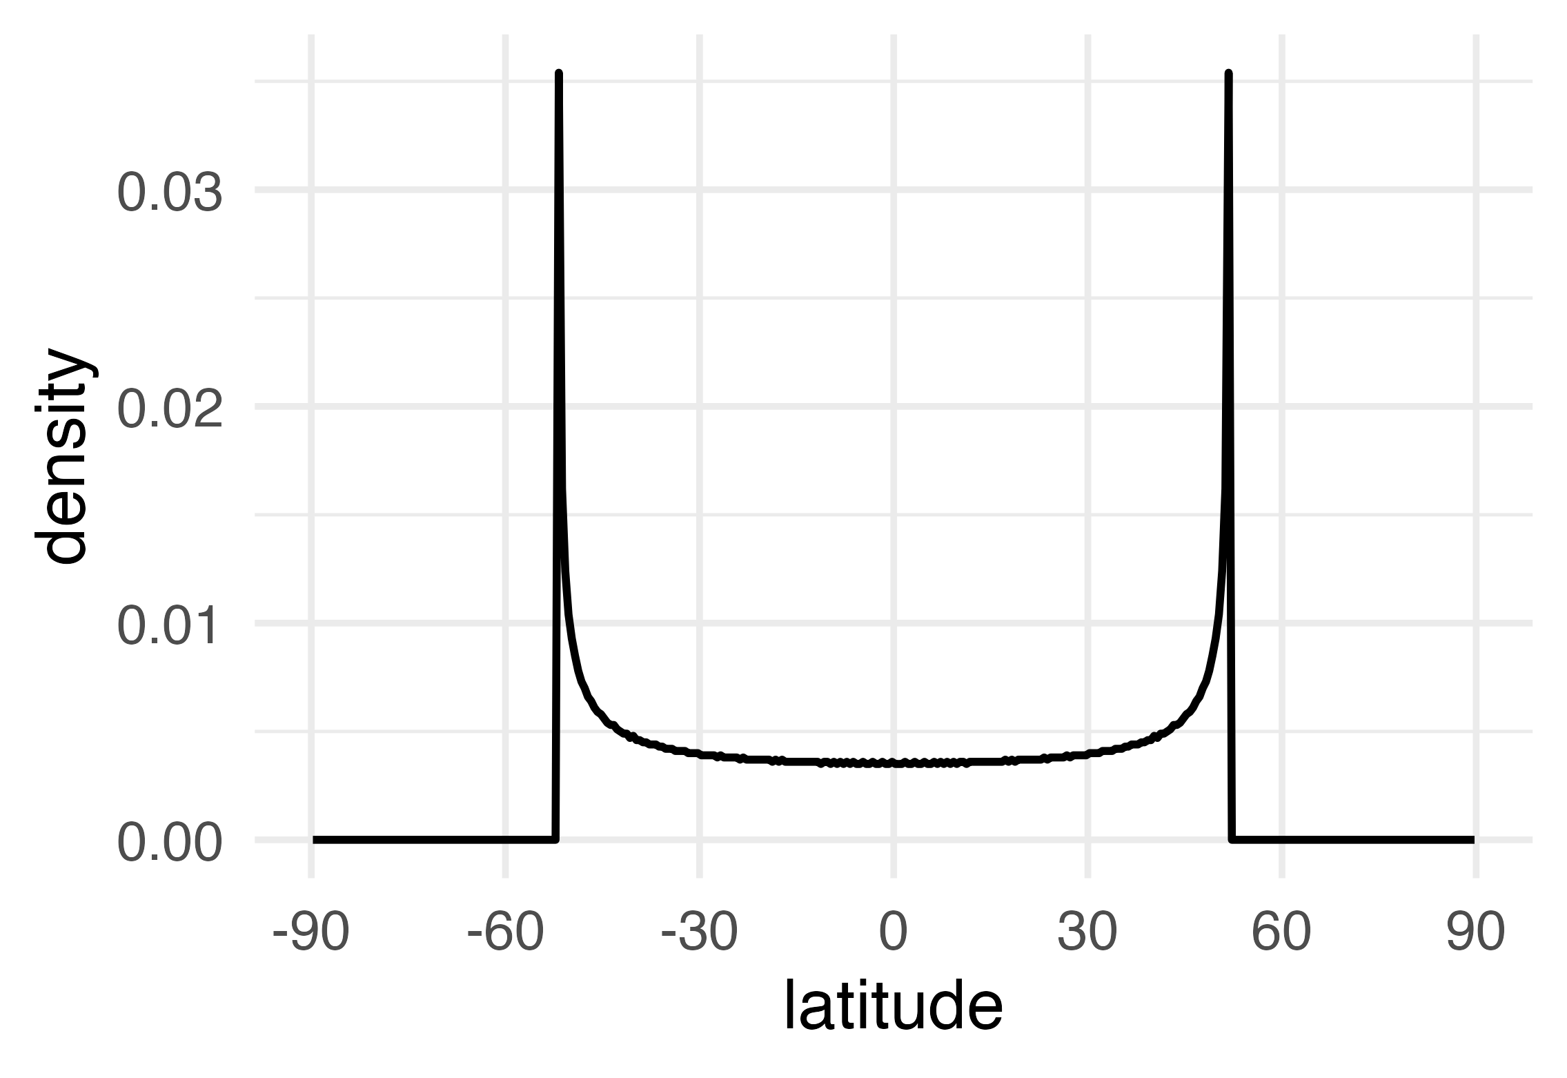
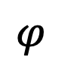
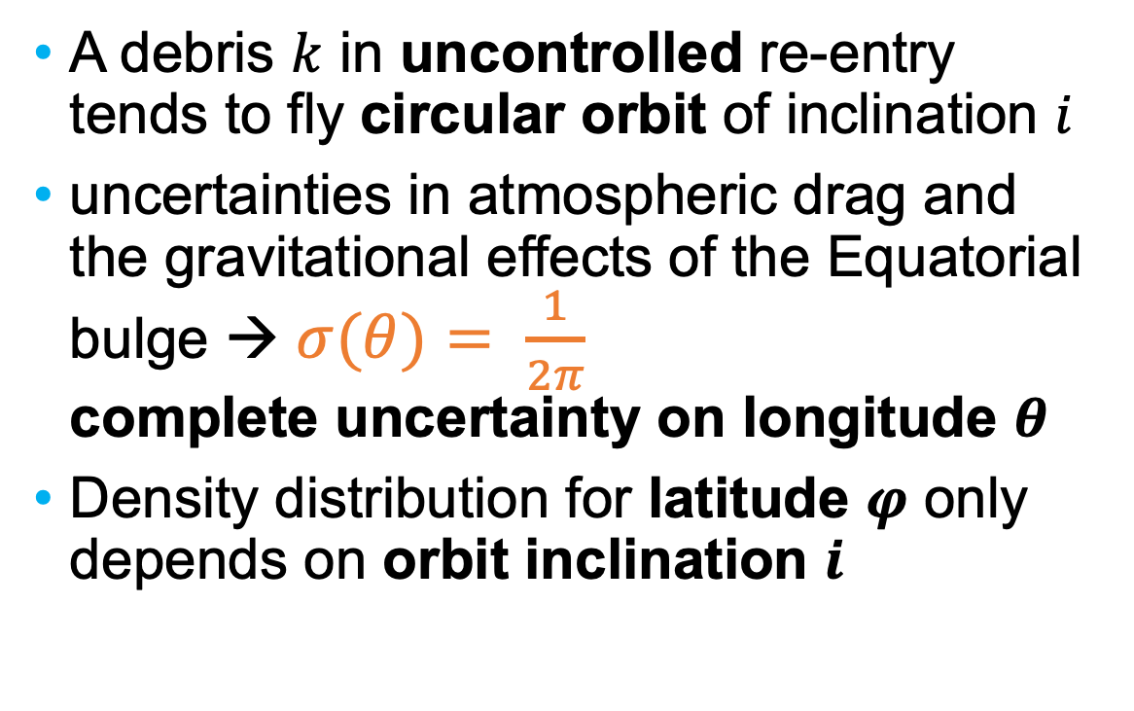
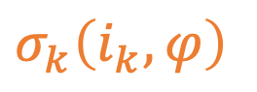
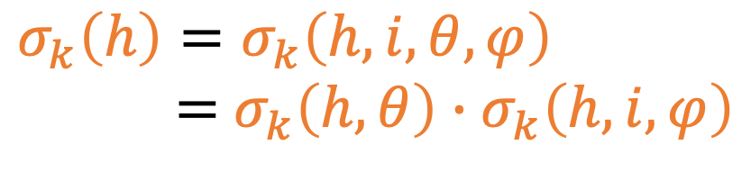
Step 4.1, impact probability density
A debris $k$ in uncontrolled re-entry tends to fly circular orbit of inclination $i$
uncertainties in atmospheric drag and the gravitational effects of the Equatorial bulge → $σ(θ)= \frac{1}{2π}$ complete uncertainty on longitude $θ$
Density distribution for latitude $φ$ only depends on orbit inclination $i$
$$σ_{k}\left(i_{k}, φ\right)$$
$$σ_{k}\left(h\right)=σ_{k}\left(h,i, θ, φ\right)$$
$=$ $σ_{k}\left(h,θ\right)∙σ_{k}\left(h,i, φ\right)$
$$φ$$
Notes:
Before falling, space debris tend to fly circular orbits.
Unpredictable effects of atmospheric drag due to variable atmosferic density (day/night/solar activities/…) and gravitational effects (equatorial bulge/…), make longitudinal density uniformily distributed, i.e. completely unknown

Slide 14
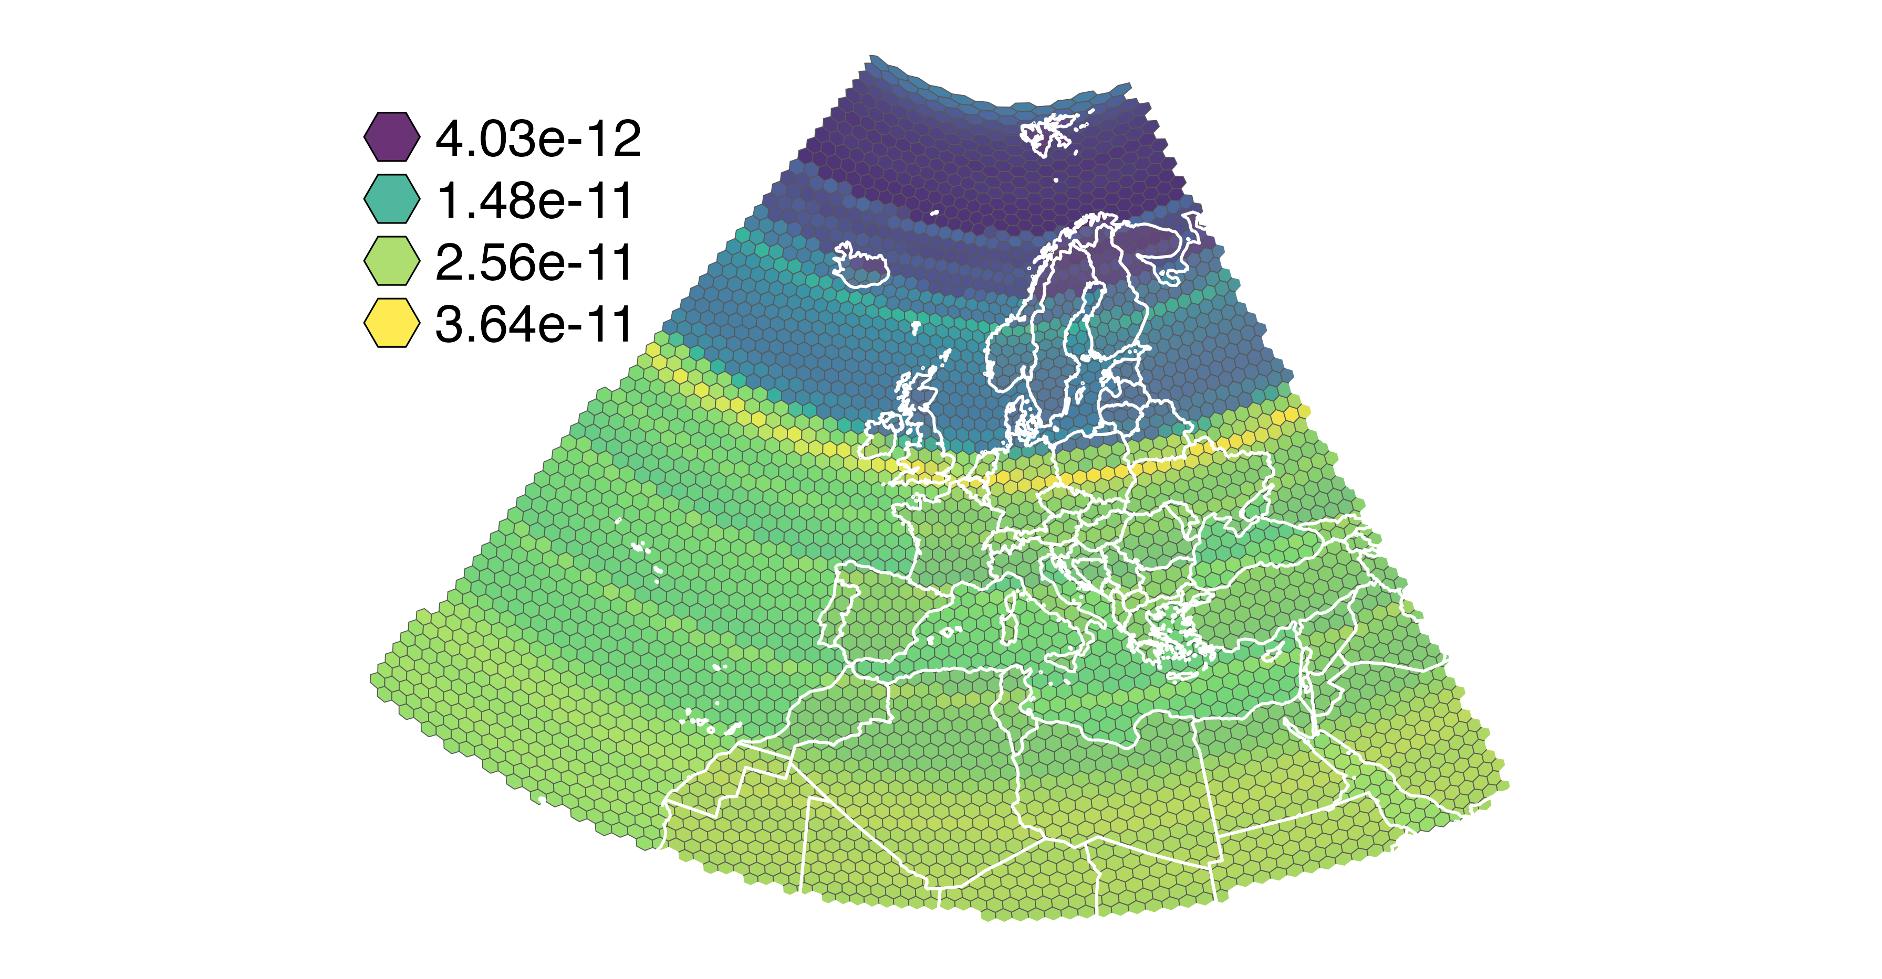
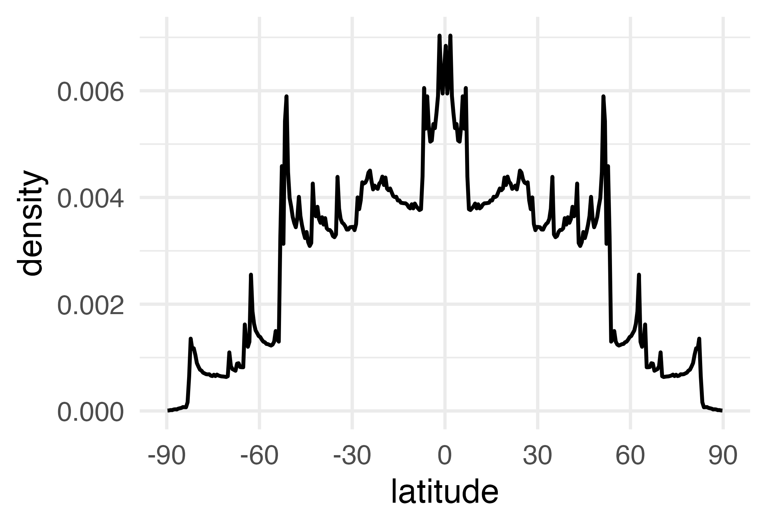
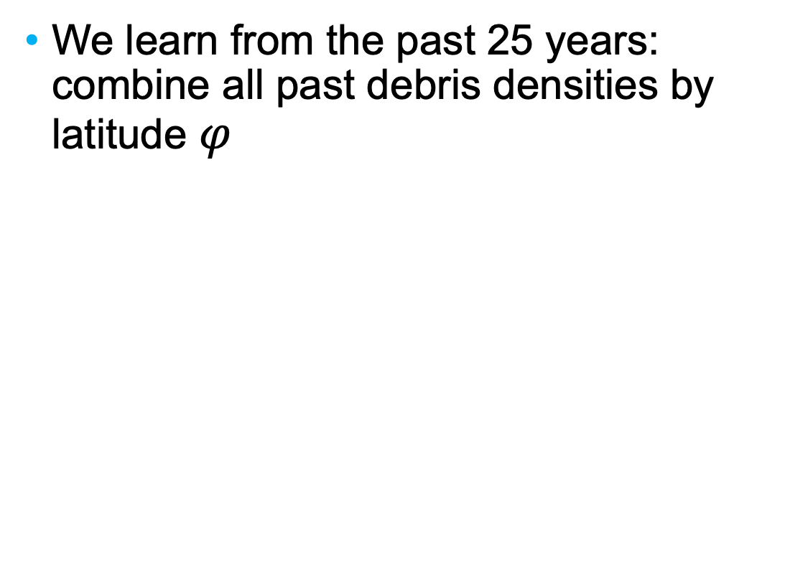

Step 4.2, impact probability density
1968 debris re-entries
We learn from the past 25 years: combine all past debris densities by latitude $φ$
→$Σ$ →
Notes:
Combine all densities foe all satellites and their different inclinations: you obtain to right bottom plot.
Transfer the right bottom density graph (and constant density on longitude) to the hex cell and you get the right top map.

Slide 15
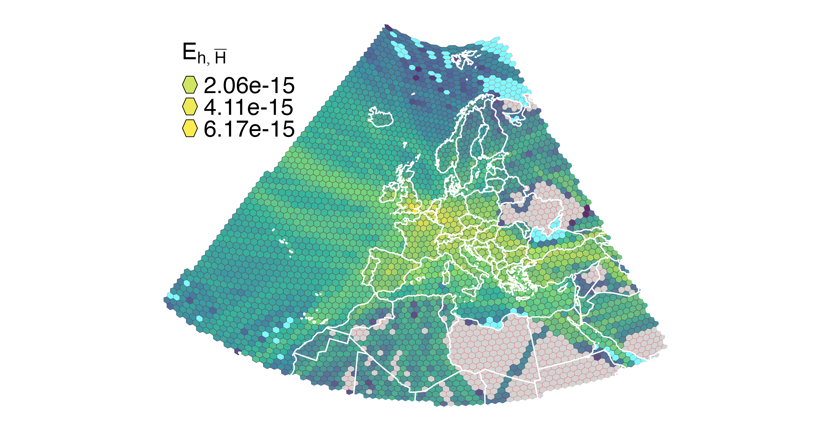




All combined, 2024-07-05 hourly
No-fly (war) zone Ukraine
North Atlantic flow
East flow
Canary Islands flow
No-fly (war) zone Libya
Notes:
Canary Islands flow probably also including South America one

Slide 16
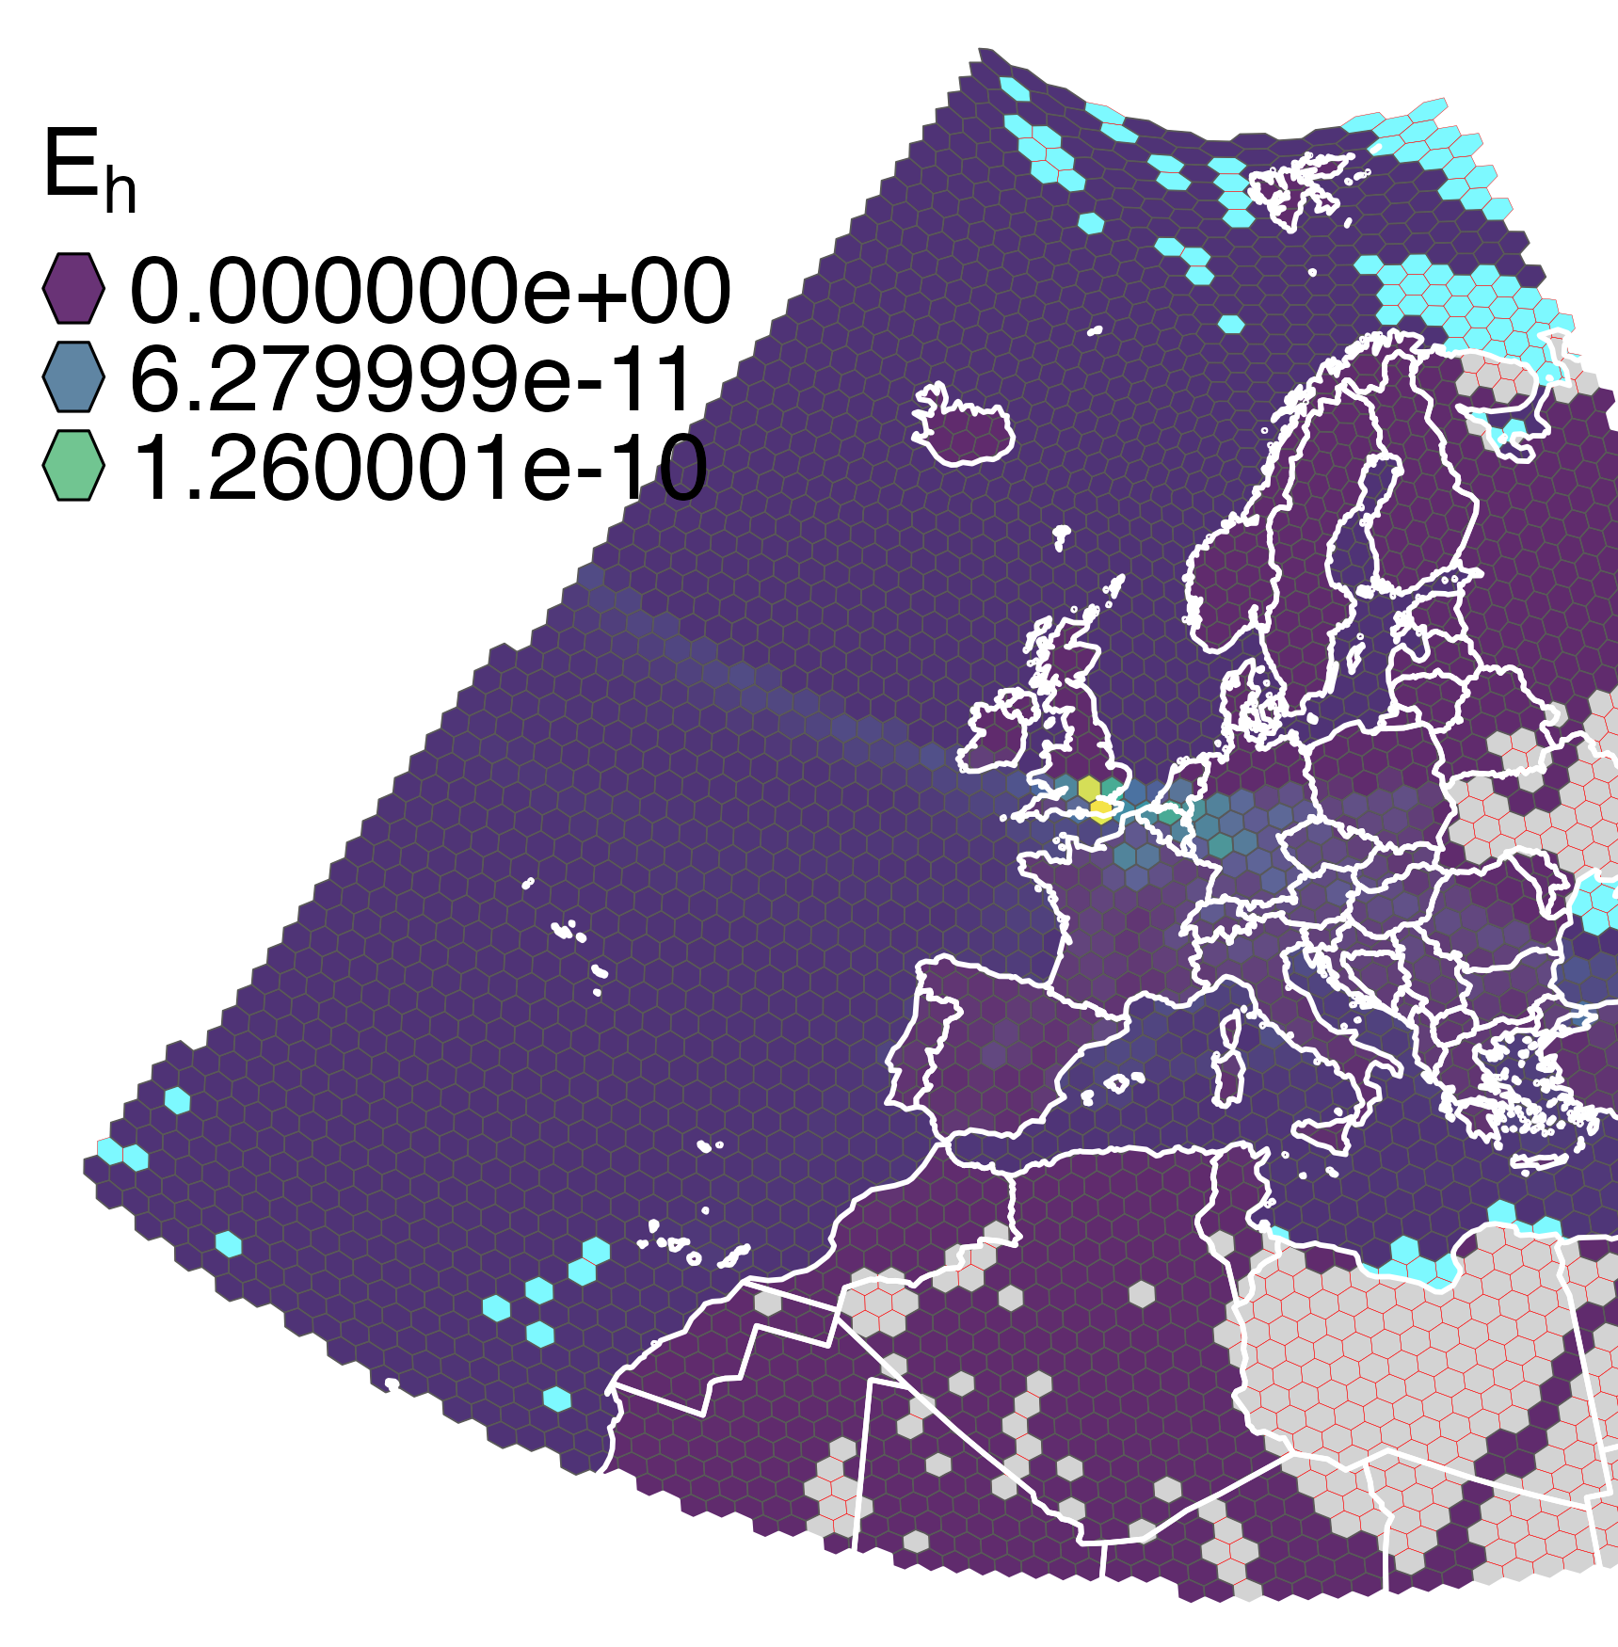
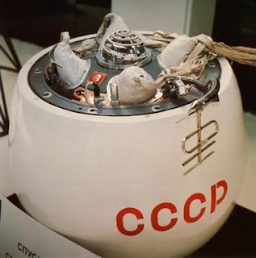
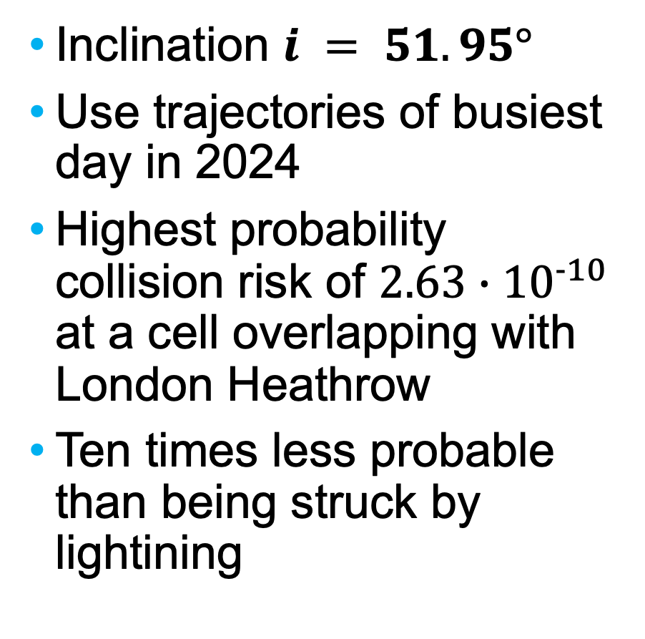
Use Case: Kosmos 482
Inclination $i = 51.95°$
Use trajectories of busiest day in 2024
Highest probability collision risk of ${2.63∙10}^{−10}$ at a cell overlapping with London Heathrow
Ten times less probable than being struck by lightining
From failed 1972 USSR Venera mission
480 kg, 1m diameter
Notes:
Note the highest HEX over Heathrow in the map

Slide 17
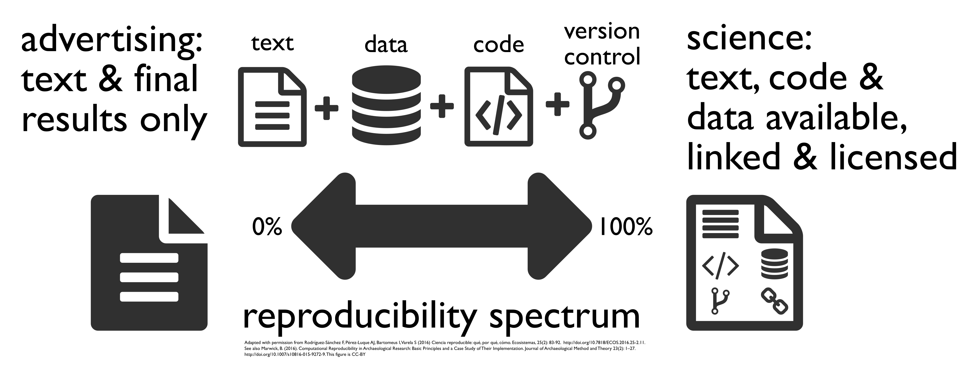
Reproducible research, 1/2
Paper source (in Quarto format) and Figures reproduction (in R) (1)
aviodebris R package for processing (2)
(partial) trajectory data (1)
(1) https://github.com/euctrl-pru/flight_density_space_debris
(2) https://github.com/euctrl-pru/aviodebris
Notes:
Let’s pass the message that reproducibility is SCIENCE

Slide 18
Reproducible research, 2/2
We are particularly indebted to
E. Wright, A. Boley, and M. Byers for their work and availability of Python code that made our learning and understanding of their research much easier
Jonathan C. McDowell for his tireless effort in keeping alive and up to date the “General Catalog of Artificial Space Objects”
Notes:
And let’s thank those who did share code and believed in reproducibility; and those doing the heavy duty on data collection/cleanup/…

Slide 19
Future work
Consider planned growing traffic and mega-constellations (with a certain rate of uncontrolled re-entries)
Compute casualties probabilities using PAX per aircraft type
Develop procedure for measures (airspace closure, re-routing) to deal with future uncontrolled re-entries or launch failures
(Consider people densities at airports ?)
Notes:
Outlook for future work

Slide 20
Thank you!
Questions/Feedback: enrico.spinielli@eurocontrol.int
www.eurocontrol.int

